Slide 1
Literary Devices / Figurative Language
Silly Sheets

Slide 2
Silly Sheet
You need: 2 sheets of LINED paper and a writing utensil (preferably a pencil)
On the LEFT SIDE of the red margin line, list each literary device.
Spread the words out evenly by skipping 3-4 spaces between words.
  NOTE: Leave 3-4 spaces at the bottom of the paper after the last word.
DO NOT CROSS THE RED LINE. Stay in the margin.
DO NOT GO ONTO THE BACK OF THE PAPER.

Slide 3
Simile
Metaphor
Personification
Allusion
Irony
Foreshadow-
ing
Imagery
DO NOT cross this line. Break the word if necessary.
Skip more lines if you can. Use the whole paper but leave 2-3 lines at the bottom for the last word.

Slide 4
Literary devices
Simile
Metaphor
Personification
Symbol
Hyperbole
Allusion
Irony
Foreshadowing
Imagery
Satire
Parody
Allegory

Slide 5
Next to each word, write the definition.
Like this:
Simile A comparison between two unlike things using the words “like” or “as.”
Metaphor A comparison between two unlike things that does NOT use the words “like” or “as.”
The definitions are on the following slides.

Slide 6
Simile
a comparison between two unlike things using the words “like” or “as”

Slide 7
Metaphor
A comparison between two unlike things that DOESN’T use “like” or “as.”
  The author says that one thing IS another instead of saying that it’s LIKE that thing.

Slide 8
Personification
When an author gives human qualities to non-human things
  Personification→object seems like a person

Slide 9


symbol
Using a concrete object to represent an abstract idea

Slide 10
hyperbole
The use of exaggeration to make a point; usually humorous

Slide 11
ALLUSION
When an author refers to a famous person, character, event, or book in the text
  Author doesn’t explain—assumes that you know the reference

Slide 12
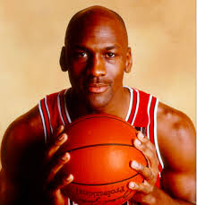
Allusion: Person
The allusion could be to a famous person (Michael Jordan or Shakespeare)…

Slide 13
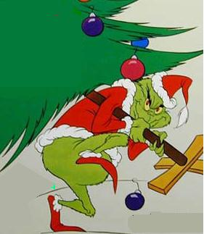
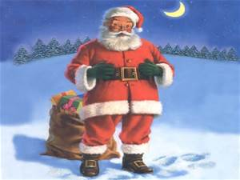
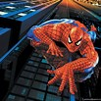
Allusion: character
A fictional character like Spiderman, Santa Claus, or the Grinch…

Slide 14
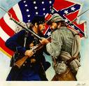
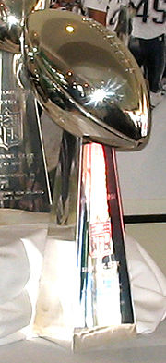
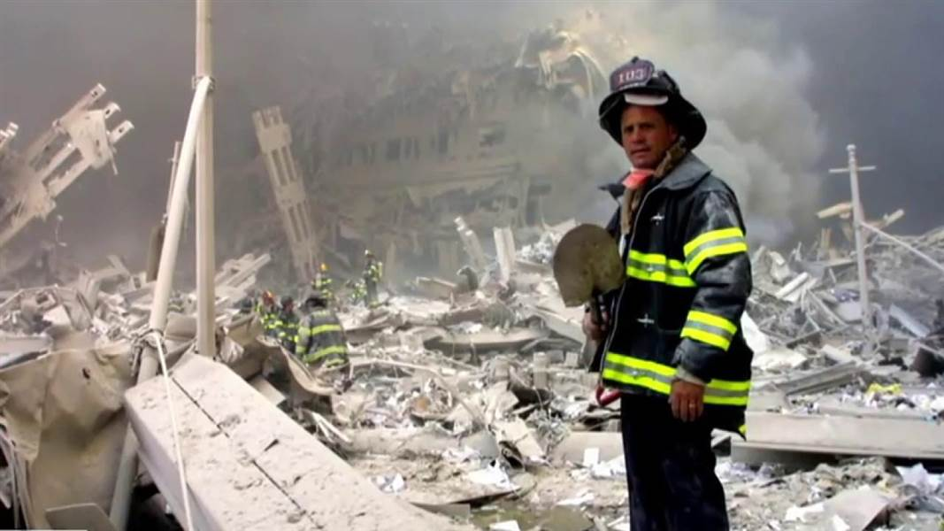
Allusion: event
An important event
(The Civil War,
the Super Bowl,
9/11)

Slide 15

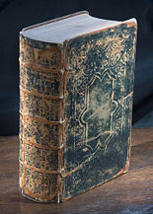
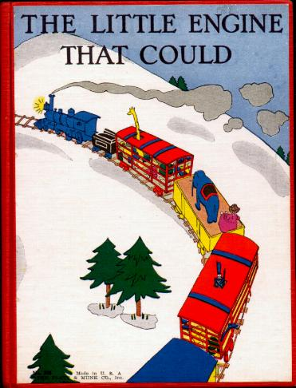
Allusion: book
Romeo and Juliet
The Bible
The Little Engine that Could

Slide 16
IRONY
You expect one thing to happen, but the opposite happens.

Slide 17
FORESHADOWING
The author gives clues about what is going to happen later in the story.

Slide 18


Imagery
Using details and descriptions in order to help the reader see, hear, taste, touch, or smell the story (5 senses)

Slide 19
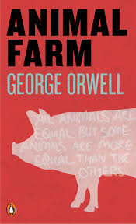
satire
A text that uses humor, irony, exaggeration, or ridicule to expose humans for their weaknesses, vices,
or stupidity; purpose is
to provoke change

Slide 20
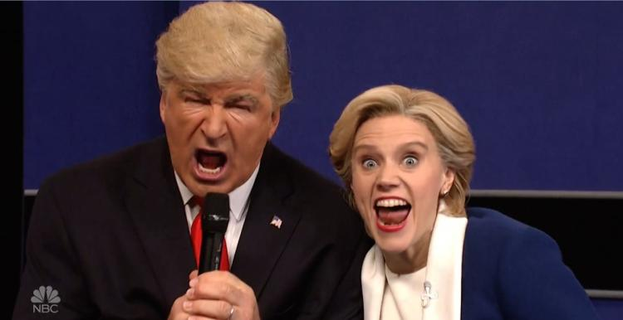
parody
A text copies someone/something in an amusing way; usually exaggerated for comedic effect

Slide 21
allegory
A text that uses the events and characters to represent ideas or teach moral lessons

Slide 22
FOLD YOUR PAPER TO THE RED LINE.
COVER THE DEFINITION BUT NOT THE WORD.
LIKE THIS:
Simile A comparison between two unlike things using the words “like” or “as.”
Metaphor A comparison between two unlike things that does NOT use the words “like” or “as.”
Fold the right edge of your paper to the red line.
Cover this part – the definition.

Slide 23
On the blank space you created by folding, write an example next to each word. Like this:
Simile The box is as light as a feather.
Metaphor Her eyes were diamonds, glittering in the moonlight.

Slide 24
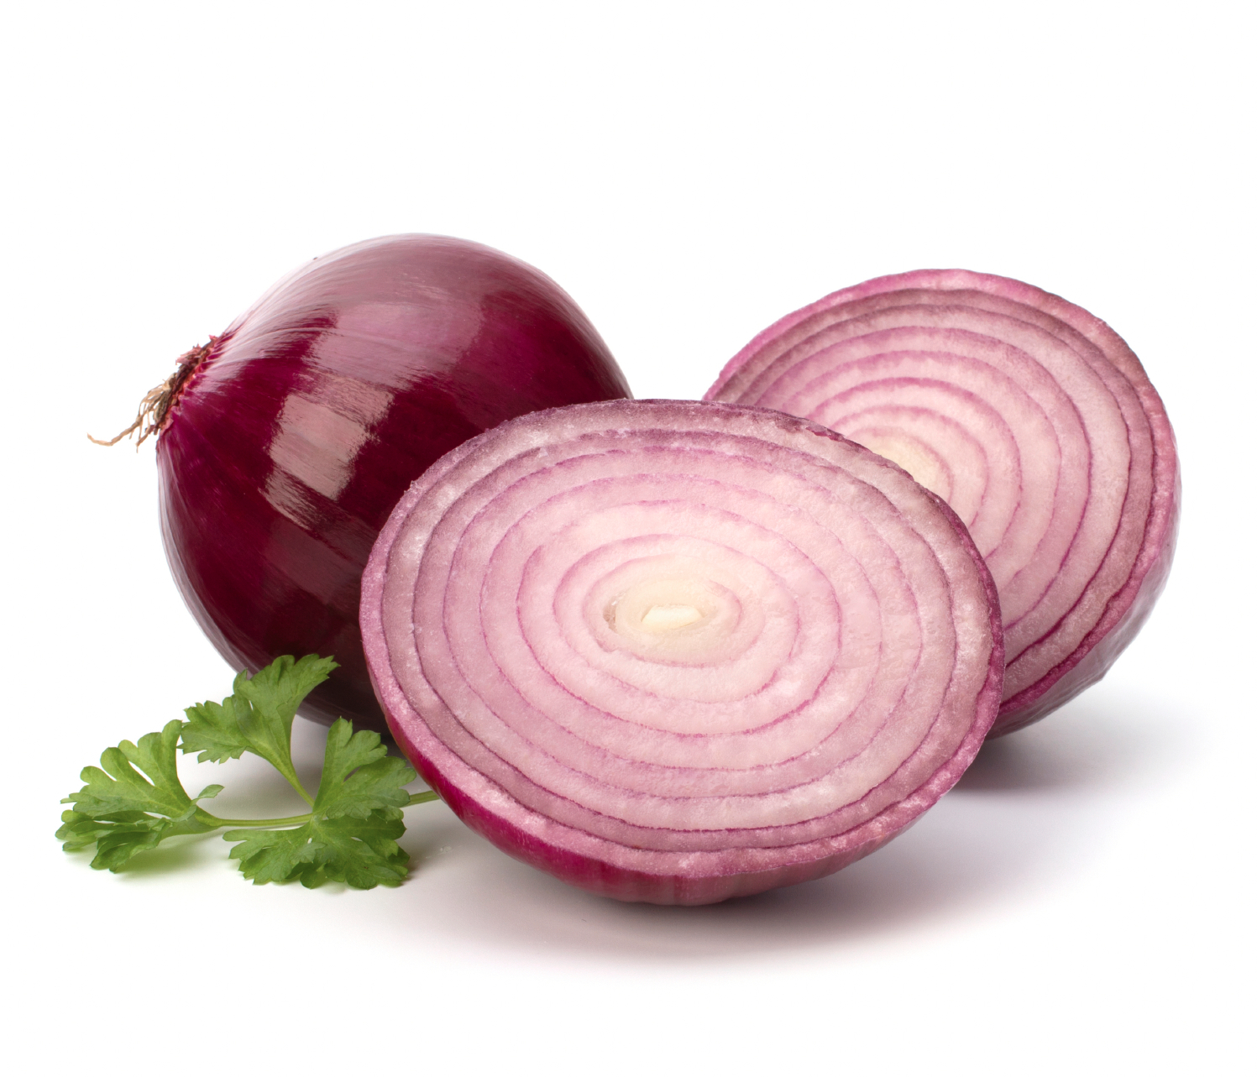
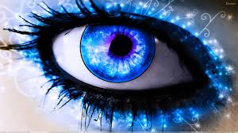

Simile Examples
"Life is like an onion: You peel it off one layer at a time, and sometimes you weep” (Carl Sandburg).
Her eyes shone
like diamonds.
The box is as
light as a feather.

Slide 25
Metaphor Examples
Her eyes were diamonds, glittering in the moonlight.
His face was ice, frozen into place and showing no trace of emotion.

Slide 26



Personification Examples
The flame danced in the breeze.
The clock ticked away happily.
The moon smiled down on me.

Slide 27
symbol Examples
A ray of light symbolizes hope.
A heart symbolizes love.

Slide 28
hyperbole Examples
I’m SO hungry; I could eat a horse!
I have a million hours of homework to do this weekend.

Slide 29

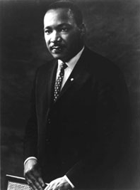
Allusion Examples
When people say, “He’s a real Romeo with the ladies” to describe a ladies’ man.
His speech reminds me of Martin
Luther King’s “I Have a Dream”
speech.

Slide 30
irony Examples
After the sniper kills his enemy, he realizes that his enemy was his own brother.
A store that is always open has a sign that says “closed.”

Slide 31
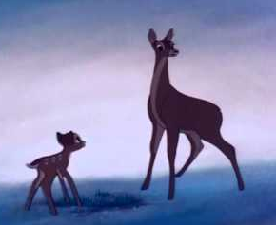
Foreshadowing Example
Bambi:
When Bambi’s mother talks about the threat of man encroaching on the forest, she foreshadows her own death.

Slide 32
Imagery Examples
Visual: The forest was dark and dim.
Auditory: The crack of the trees startled her.
Smell: The aroma of freshly brewed coffee filled the room.
Taste: The orange was juicy and sweet.
Touch: The softness of the blanket made it easy to fall asleep.

Slide 33
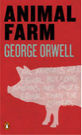
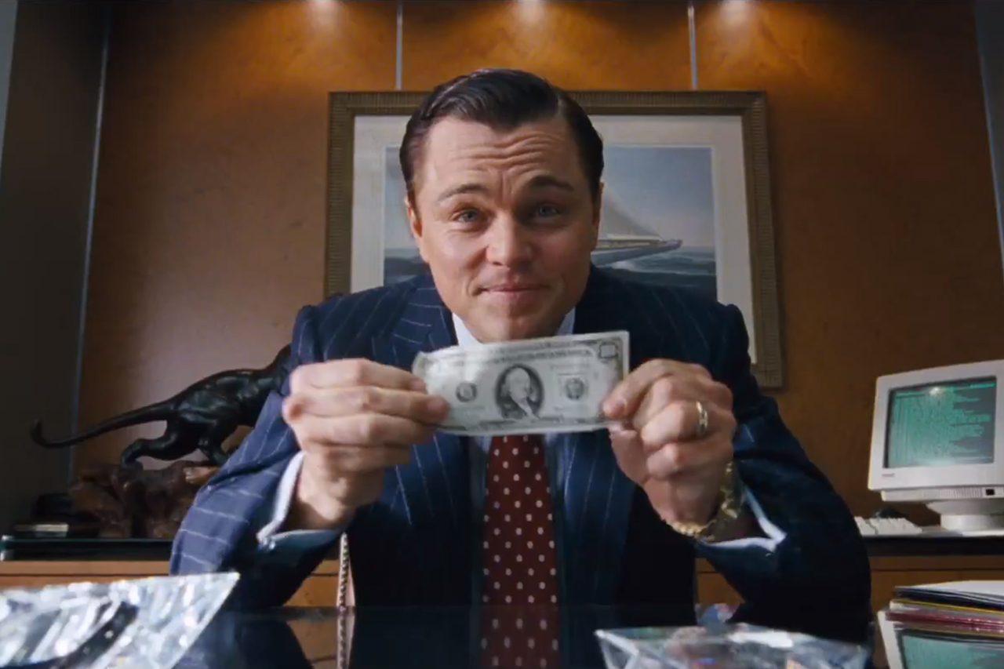
satire examples
Animal Farm by George Orwell: The animals represent actual people involved in the Russian Revolution and how corrupt politics can be.
The Wolf of Wall Street: The lust and greed shown by the characters in this movie reveal how immoral the stockbroking business can be.

Slide 34

Parody examples
SNL presidential debate skits: The writers take what Trump and Clinton have actually said and make fun of it.
YouTube videos: People who take popular songs and write their own versions are writing parodies of the original songs.

Slide 35
allegory example
Animal Farm is an allegory meant to teach a lesson about politics and government.

Slide 36
Adding clues
Fold the paper one more time to cover up the examples you just wrote, but keep the word showing.
Draw or write a clue to help you remember what the word means.

Slide 37
Quiz Yourself
Fold the words back in the opposite direction so that you have a thin strip with the words on one side and the clues on the other.
Try to remember what each word means without even looking at the clue.
If you need the clue, flip the strip over.
If you still don’t know, open one flap of the paper and use the example to help you.
If you still don’t know, open the paper all the way and read the definition.
Keep quizzing yourself on the ones you are getting wrong until you know all of the words without even looking at the clues.

Slide 38
Works cited
Richardson, Christian. "SILLY SHEETS LITERARY DEVICES / FIGURATIVE LANGUAGE." - Ppt Download. Slide Player, n.d. Web. 23 Oct. 2016.

