Slide 1
Vocabulary list 6

Slide 2
Determine, verb
Emphasis, noun
Predict, verb
Prohibit, verb
Relevant, adj.
Revolution, noun
Significant, adj.
Tradition, noun

Slide 3
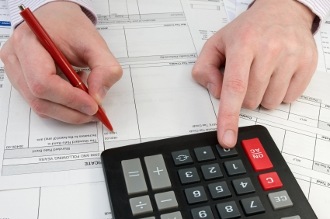
Determine, verb
Def: to find out the facts or make a decision
Sentence: In order to determine the answer to the math problem, you must use the correct formula.

Slide 4
Does this sentence make sense?
Thumbs up = yes
Thumbs down = no
Thumbs in the middle = I don’t know
Before buying a house, you should first determine if you can afford it.
The laws our government makes never determines the success of our economy.

Slide 5
Emphasis, noun
Def: special attention or importance
Sentence: When someone types certain words in all caps, they are putting emphasis on those words.

Slide 6
Does this sentence make sense?
Thumbs up = yes
Thumbs down = no
Thumbs in the middle = I don’t know
Mrs. Finley’s late work policy puts an emphasis on student responsibility.
When applying for a job, you should not emphasize your good qualities.

Slide 7
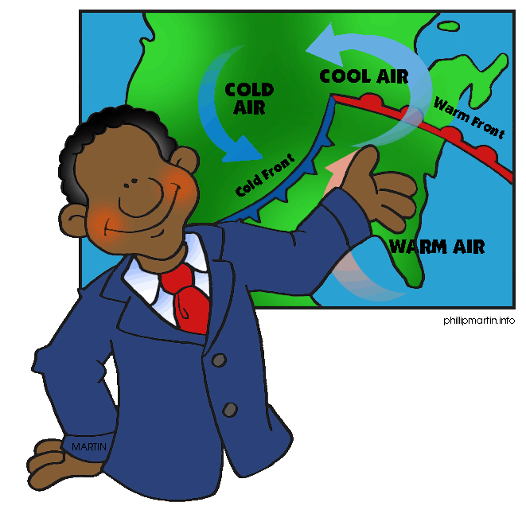
Predict, verb
Def: to guess something will happen before it does
Sentence: Meteorologists use their knowledge to predict weather patterns.

Slide 8
Make a prediction: what will happen next?

Slide 9
Prohibit, verb
Def: to say an activity is not allowed; forbid
Sentence: Due to the health hazards they cause, smoking cigarettes is prohibited in many public places.

Slide 10
Does this sentence make sense?
Thumbs up = yes
Thumbs down = no
Thumbs in the middle = I don’t know
Our first amendment says we are prohibited from ever being able to speak freely.
Some parents prohibit their kids from staying out past curfew because they worry about their safety.

Slide 11
Relevant, adj.
Def: directly related to a topic
Sentence: If you want to make a good argument, you should use relevant evidence to support your claim.

Slide 12
Pair/share
With your neighbor, create an argument that proposes a change to our school dress code (i.e. Students should be able to wear plain white t-shirts). Then, with come up with one relevant piece of information/evidence that supports your argument.

Slide 13
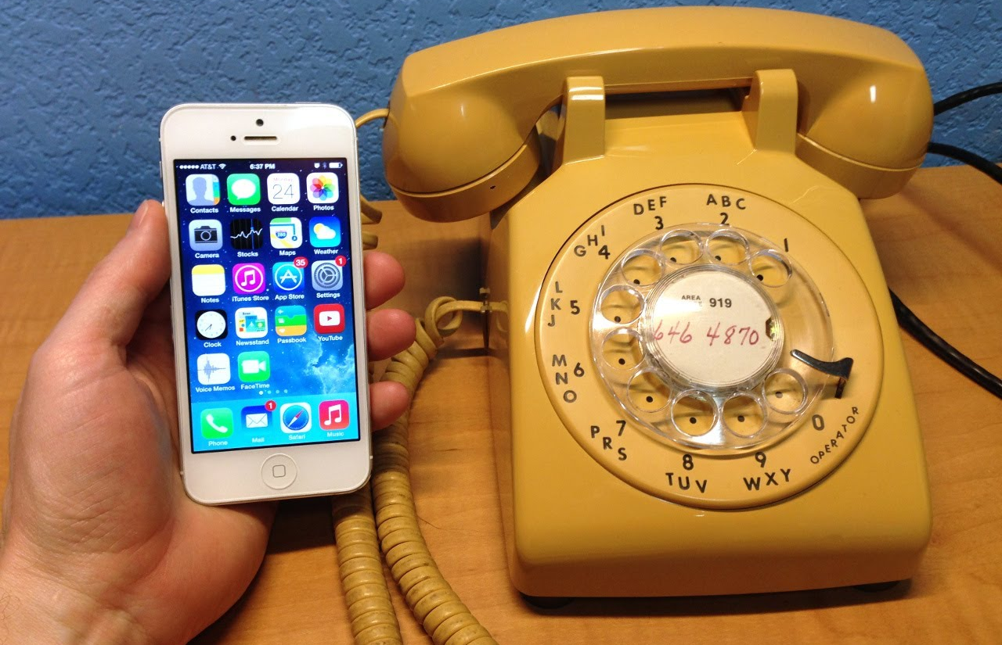
Revolution, noun
Def: a change in thought that creates change in structure or beliefs
Sentence: The iPhone represents a revolution in our culture since it changed so many things about our world.

Slide 14
Pair/share
What is something you feel so strongly about that you would be willing to start (or join) a revolution that changed it?

Slide 15
Significant, adj.
Def: having an important effect OR large enough to be noticeable
Sentence: The amount of sleep a student gets has a significant effect on their success in school.

Slide 16
Pair/share
Is there a significant difference between living in the city and living in the mountains? Explain.

Slide 17
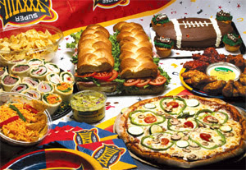
Tradition, noun
Def: belief/way of doing something that has existed for a long time
Sentence: In American culture, it is a tradition for people to have Super Bowl parties.

Slide 18
Pair/share
What’s one of your family traditions? How long has this tradition lasted?

