Slide 1
Vocabulary list 5

Slide 2
Write each word and its part of speech in the spaces provided on your vocabulary study chart.
Government, noun
Infer, verb
Involve, verb
Neutral, adj.
Oppose, verb
Policy, noun
Precedent, noun

Slide 3
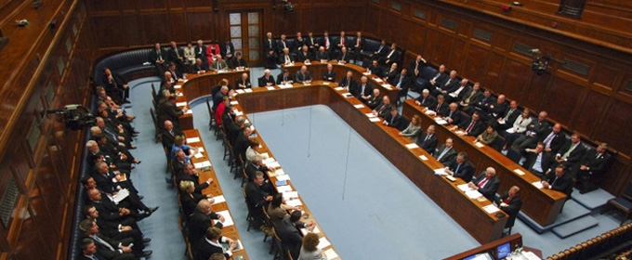
Government, noun
Def: group of people that run a country/state/city
Sentence: In the United States government, the legislative branch creates laws.

Slide 4
Does this sentence make sense?
Thumbs up = yes
Thumbs down = no
Thumbs in the middle = I don’t know
California and Arizona have the same state government.
Government officials can sometimes be corrupt.

Slide 5
Infer, verb
Def: making an educated guess based on given information
Sentence: Based on the clues, the detective inferred that the victim walked into the store around 9:00 pm.
Notes:
Because the young girl was crying and there was no adult with her, I inferred that she was lost.
My fiance inferred that he was annoyed when he rolled his eyes at me.

Slide 6
Does this sentence make sense?
Thumbs up = yes
Thumbs down = no
Thumbs in the middle = I don’t know
Because the young girl was crying and there was no adult with her, I inferred that she was lost.
My husband inferred that he was annoyed with me when he rolled his eyes.

Slide 7
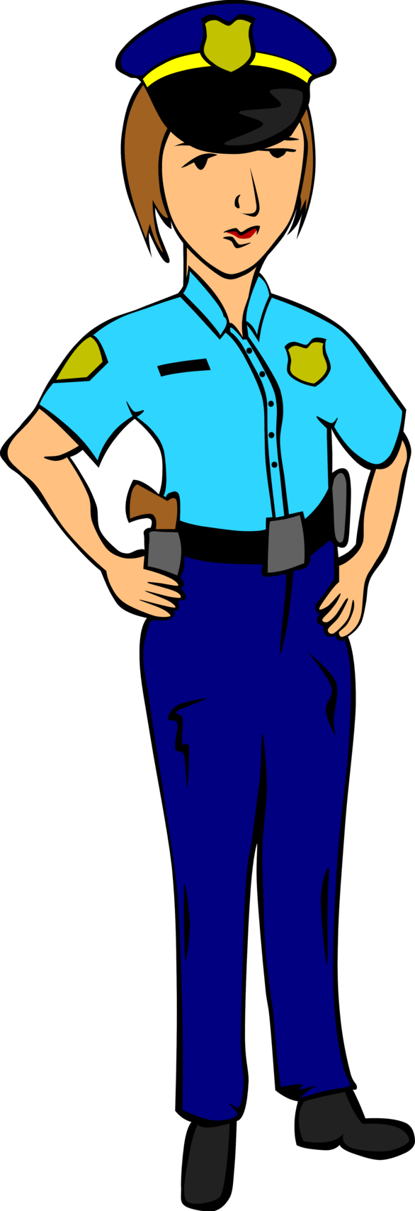
Involve, verb
Def: to include someone/something in an activity; to participate
Sentence: When my home was robbed, I involved the police in hopes of catching the thief.
Notes:
What is something you’re involved in here at school?
In what situations do you wish people would not get involved in your personal life?

Slide 8
Pair/share
What is something you’re involved in here at school?
In what situations do you wish people would NOT get involved in your personal life?

Slide 9
Neutral, adj.
Def: not supporting any side in an argument; in the middle
Sentence: Whenever my parents argue, I choose to stay neutral; it’s not my place to take sides.
Notes:
People who are pro life are neutral when it comes to abortion.
People who don’t care whether or not gay marriage is legalized are neutral.

Slide 10
Does this sentence make sense?
Thumbs up = yes
Thumbs down = no
Thumbs in the middle = I don’t know
People who want stricter gun control are neutral when it comes to the 2nd amendment.
People who don’t care whether or not gay marriage is legalized are neutral on that particular issue.

Slide 11
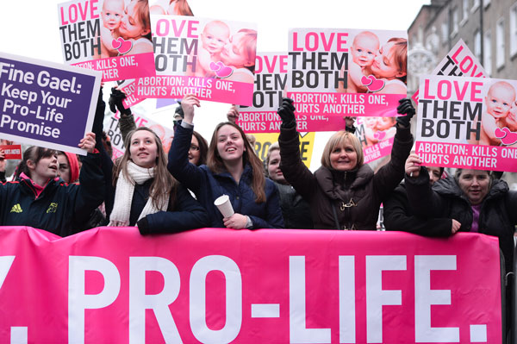
Oppose, verb
Def: to disagree with/go against
Sentence: Abortion is a controversial issue in America; some people oppose it because they think it’s murder.

Slide 12
Does this sentence make sense?
Thumbs up = yes
Thumbs down = no
Thumbs in the middle = I don’t know
When people protest, they are showing that they oppose what’s happening in society.
Most students oppose the fact that we have 2 weeks off for winter break.

Slide 13
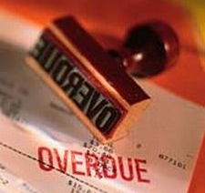
Policy, noun
Def: an established way of doing something
Sentence: The bank’s policy is that customers are charged a fee each time their payment is late.

Slide 14
Pair/share
What do you know of most clothing stores’ return policies?
What is Mrs. Finley’s late work policy? (How much credit does late work earn? Is there a due date for late work?)

Slide 15
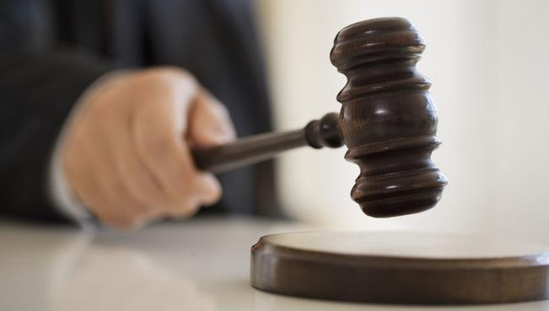
Precedent, noun
Def: an event that’s used as an example to support a later action/decision
Sentence: The fight that caused a student’s death set the precedent that any other students caught fighting would be expelled.

Slide 16
Does this sentence make sense?
Thumbs up = yes
Thumbs down = no
Thumbs in the middle = I don’t know
Julia’s perfect test scores set the precedent that she was the smartest kid in her class.
A precedent of Mrs. Jones being caring is that she gives Roger money to buy the shoes he wants.

