Slide 1
Vocabulary list 4

Slide 2
Write each word and its part of speech in the spaces provided on your vocabulary study chart.
Analyze, verb
Contribute, verb
Debate, verb
Diverse, adj.
Economy, noun
Establish, verb
Exploit, verb

Slide 3
Analyze, verb
Def: to separate into parts and study/discuss each part
Sentence: Mrs. Finley’s English 1 students analyzed the sniper’s character by studying his actions in different parts of the story.
Notes:
Investigators do NOT need to analyze evidence in order to determine how crimes were committed. (Yes/No)
Do girls tend to over-analyze what guys do or say? Why? Explain.

Slide 4
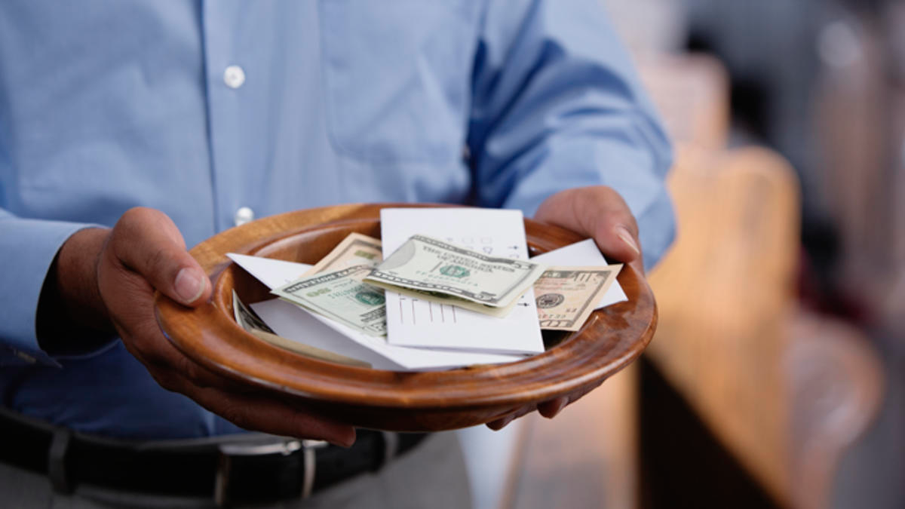
contribute, verb
Def: to give help, money, time, ideas, etc. to make something happen
Sentence: Every Sunday, Jim contributes money to his church so that it can continue to function.
Notes:
1) I contributed to the party by bringing a fruit salad. (Yes/No)
2) When you do group projects, does everyone contribute an equal amount? Or does one person do all of the work?

Slide 5
debate, verb
Def: to share different opinions during a discussion
Sentence: The presidential candidates debate many issues; they discuss their opinions on things such as education, health care, and immigration.
Notes:
One topic that people like to debate is gun control. (Yes/No)
A successful debate is one where people are angrily yelling at each other. (Yes/No)

Slide 6
Diverse, adj.
Def: different from others/having many differences
Sentence: SDSU has a diverse student population since many different types of students attend that school.
Notes:
Ms. Wanser’s students are not diverse. (Yes/No)
Our oceans are home to a diversity of species. (Yes/No)

Slide 7
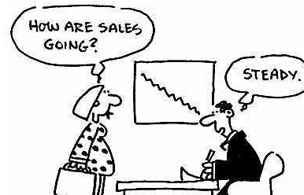
Economy, noun
Def: a system of trade/money/labor that determines the wealth of a nation
Sentence: In 2008, our country’s economy suffered a major crisis during which businesses closed and people lost jobs.

Slide 8
establish, verb
Def: to start something that will exist/happen for a long time
Sentence: Ford Motor Company was established in 1903; now, over 100 years later, it is still in business.

Slide 9
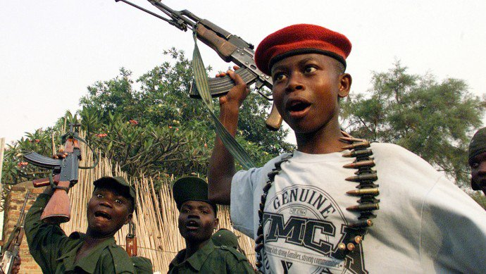
exploit, verb
Def: to treat someone unfairly in order to get what you want
Sentence: Some children in countries around the world are exploited by adults and forced into becoming soldiers.

