Slide 1
Vocabulary list 3

Slide 2
Write each word and its part of speech in the spaces provided on your vocabulary study chart.
Circumstance, noun
Compare, verb
Contrast, verb
Demonstrate, verb
Evaluate, verb
Imply, verb
Participate, verb
Potential, noun

Slide 3
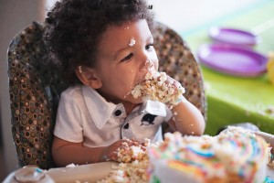
Circumstance, noun
Def: a condition that changes a situation
Sentence: Caleb isn’t usually allowed to eat sugar, but he gets cake on his birthday since it’s a special circumstance.

Slide 4
compare, verb
Def: to find similarities
Sentences: Josh compared two different engagement rings, noting their similarities, before finally buying one.

Slide 5
Contrast, verb
Def: to find differences
Sentence: Rainsford’s attitude about hunting humans contrasts with Zaroff’s; Rainsford thinks it’s murder while the general finds it appropriately thrilling.

Slide 6
Demonstrate, verb
Def: to show or prove something clearly
Sentence: In order to properly prepare people to perform CPR, trainers must demonstrate the correct technique.

Slide 7
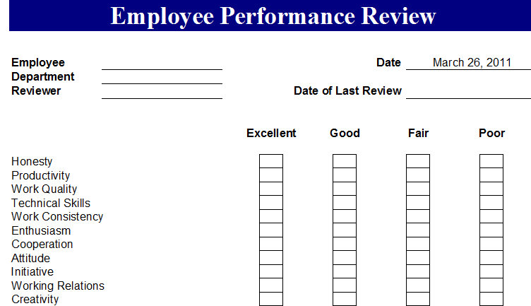
evaluate, verb
Def: to carefully think about in order to form an opinion
Sentence: At most jobs, bosses are required to evaluate how well their employees are doing.

Slide 8
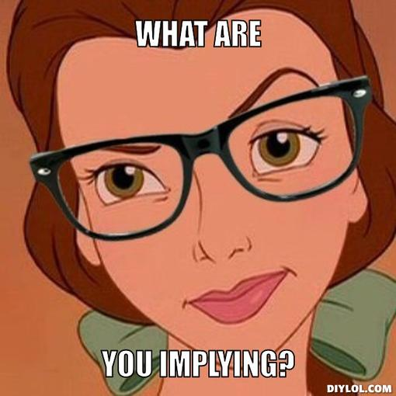
imply, verb
Def: to hint at something without saying it directly
Sentence: “What are you implying?” asked Belle after her boyfriend suggested that she not eat dessert.

Slide 9
Participate, verb
Def: to take part in an event
Sentence: Mrs. Finley has many students who participate in class; they always raise their hand to answer questions.

Slide 10
Potential, noun
Def: the possibility that something will occur
Sentence: Mrs. Finley believes that every student has the potential to succeed as long as they work hard.

