Slide 1
Vocabulary list 2

Slide 2
Write each word and its part of speech in the spaces provided on your vocabulary study chart.
Acquire, verb
Affect, verb
Conclude, verb
Consequence, noun
Interpret, verb
Occur, verb
Specific, adj.
Sufficient, adj.

Slide 3
Acquire, verb
Def: to get or buy something
Sentence: One way to acquire knowledge is to read; books teach us many things.

Slide 4
affect, verb
Def: to cause a change
Sentence: Being hungry negatively affects my mood; I get “hangry.”

Slide 5
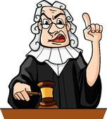
Conclude, verb
Def: to decide if something is true or false after considering all the information
Sentence: The judge concluded that the defendant was guilty of the crime.

Slide 6
Consequence, noun
Def: something that happens as a result of another action
Sentence: One of the consequences of slacking off in school is the possibility of failing.

Slide 7
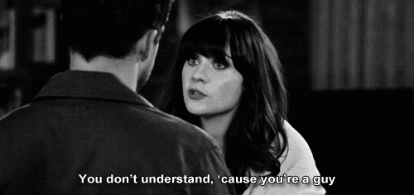
Interpret, verb
Def: to understand or explain the meaning of an idea or action
Sentence: Men are often trying to interpret what women say, but they never seem to understand.

Slide 8
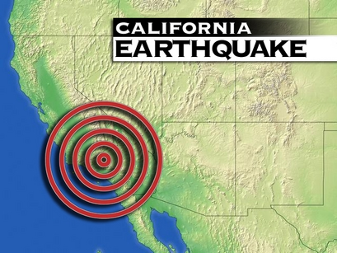
Occur, verb
Def: to happen
Sentence: Here in California, earthquakes could occur at any moment.

Slide 9
Specific, adj.
Def: to pay attention to a particular part
Sentence: My boss has such a specific way of filing papers that she won’t let anyone else do it.

Slide 10
Sufficient, adj.
Def: to have enough for a particular purpose
Sentence: I ate a sufficient amount of food for lunch; I’m no longer hungry, but I’m also not full.

