Slide 1
Vocabulary list 1

Slide 2
List 1
Write each word and its part of speech in the spaces provided on your vocabulary study chart. (You will fill a synonym in later).
Antagonistic, adj.
Approach, verb
Authority, noun
Available, adj.
Benefit, noun
Evident, adj.
Judicious, adj.
Meticulous, adj.
Pompous, adj.

Slide 3
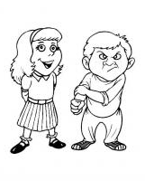
Antagonistic, adj.
Def: to disagree or be unfriendly to a person or group
Sentence: The antagonistic boy had no friends because he was mean to everyone.

Slide 4
Approach, verb
Def: to move toward or ask for something
Sentence: As she approached the end of high school, Jane couldn’t decide whether to go to college or not.

Slide 5
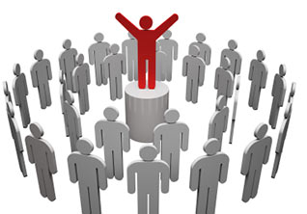
Authority, noun
Def: a person/group in power
Sentence: The president of the bank has authority over each of her employees.

Slide 6
Available, adj.
Def: something that is easy to find or buy
Sentence: These days, Wi-Fi access is available nearly everywhere.

Slide 7
Benefit, noun
Def: helpful or brings success
Sentence: Exercise has many benefits, including increased energy, improved muscle tone, and weight loss.

Slide 8
Evident, adj.
Def: easily noticed or understood
Sentence: It is evident by their body language that this couple is fighting.

Slide 9
Judicious, adj.
Def: making wise decisions
Sentence: Since I don’t have much money, I must be judicious about what I buy.

Slide 10
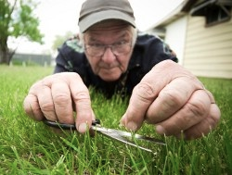
meticulous, adj.
Def: very careful about details
Sentence: My grandpa is so meticulous about his lawn that he cuts the grass by hand.

Slide 11
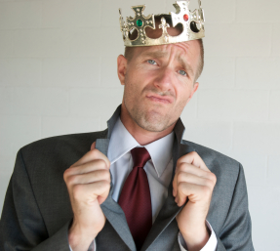
pompous, adj.
Def: overconfident, making people think they are more important than others
Sentence: The pompous businessman thinks he’s “the man” because he had the most sales this year.

